Slide 1
Database Management System
Mr. Shrikrishna Anand Narvekar
Assitant Professor
Computer Engineering department
Agnel Institute of Technology and Design

Slide 2
Introduction to database system
Database management system consist of two parts:
Database
Management system
To understand what is database let’s first understand what is data?
Data is a raw and unprocessed fact that has been organized and processed and interpreted to make sense
E.g 1, ABC, 19 has no particular meaning

Slide 3

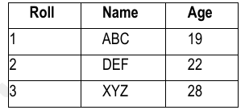
Introduction to database system
Record: It is collection of related data item
Table or relation: Collection of related records

Slide 4
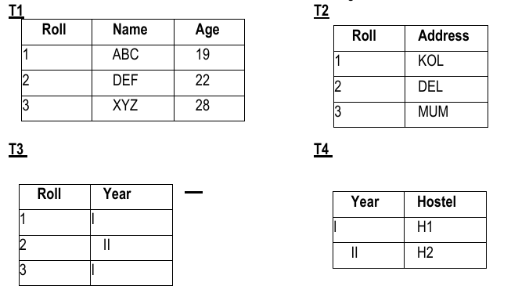
Introduction to database system
Databases: Collection of related relations

Slide 5
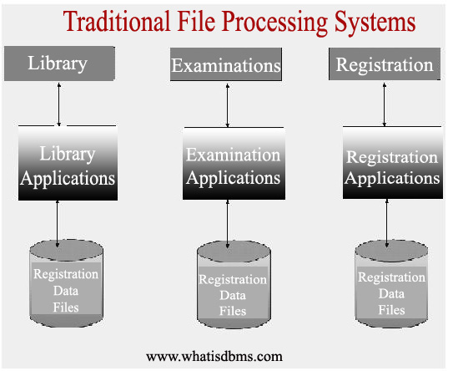
Traditional File system
Traditional File Processing System:
Library Applications, Examination Applications, and Registration Applications, are shown as independent systems, each with its own data files. These systems appear to manage their own datasets, which creates a number of challenges in terms of data redundancy, inconsistency, and inefficiency.

Slide 6
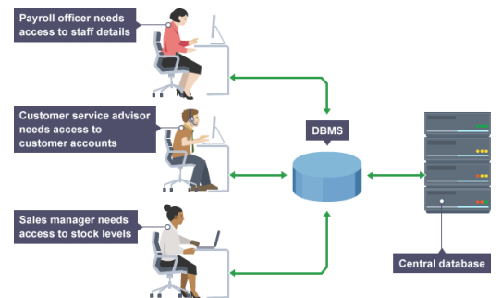
What is database
A database in a DBMS could be viewed by lots of different people with different responsibilities.
Each employee in the company will have different levels of access to the database with
their own customized front-end application

Slide 7
Purpose of a Database System
Data Integration
Data Redundancy and Inconsistency
Data Independence
Efficient data access
Security and Authorization
Backup and recovery

Slide 8
Database system and its Applications
Banking: For customer information, accounts, loans, and banking transactions.
Credit card transactions: For purchases on credit cards and generation of monthly statements.
Finance: For storing information about holdings, sales, and purchases of financial instruments such a stocks and bonds; also for storing real-time market data to enable online trading by customers and automated trading by the firm.

Slide 9
Database system and its Applications
Universities: For student information, course registrations, and grades (in addition to standard enterprise information such as human resources and accounting).
Airlines: For reservations and schedule information. Airlines were among the first to use databases in a geographically distributed manner.
Telecommunication: For keeping records of calls made, generating monthly bills, maintaining balances on prepaid calling cards, and storing information about the communication networks.

Slide 10
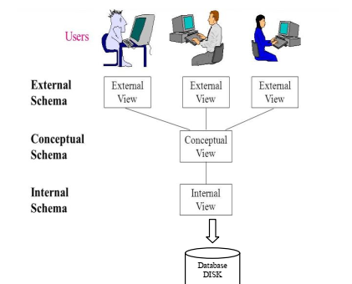
View of the Data
Database system provides users with an abstract view of the data.
The system hides certain details of how the data are stored and maintained.
Data Abstraction
For the system to be usable, it must retrieve data efficiently
Use complex data structures to represent data in the database
Developers hide the complexity from users through several levels of abstraction

Slide 11
Data Abstraction
Physical level (or Internal View / Schema)
  Describes how the data are actually stored in the file system.
Logical level (or Conceptual View / Schema)
  describes what data are stored in the database, and what relationships exist among those data.
View level (or External View / Schema):
  simplify their interaction with the system.

Slide 12
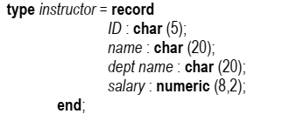
Data Abstraction
instructor, department, or student record can be described as a block of consecutive
storage locations – low level
Each such record is described by a type definition, as in the previous code segment, and the
interrelationship of these record types is defined as well.- Logical level
View level, computer users see a set of application programs that hide details of the data types

Slide 13
Data Models
Data model:
  a collection of conceptual tools for describing data, data relationships, data semantics, and consistency constraints.
  Describe the design of a database at the physical, logical, and view levels.
Categories of data models
Relational models
  Uses a collection of tables to represent both data and the relationships among those data
  Also known as record-based model
    Database is structured in fixed-format records of several types.
    Each table contains records of a particular type.
    Each record type defines a fixed number of fields, or attributes.
    The columns of the table correspond to the attributes of the record type

Slide 14
Data Models
Entity-Relationship Model.
  Collection of basic objects, called entities, and relationships among these objects.
  An entity is a “thing” or “object” in the real world that is distinguishable from other objects.
  The entity relationship model is widely used in database design.

Slide 15
Data Models
Object-Based Data Model.
  Extending the E-R model with notions of encapsulation, methods (functions), and object identity.
  The object-relational data model combines features of the object-oriented data model and relational data model

Slide 16
Data Models
Semi-structured Data Model.
  The semi-structured data model permits the specification of data where individual data items of the same type may have different sets of attributes.
  This is in contrast to the data models mentioned earlier, where every data item of a particular type must have the same set of attributes.
  The Extensible Markup Language (XML) is widely used to represent semi-structured data

Slide 17
Database languages
Data Manipulation Language (DML): This is a type of language used to work with data that is organized in a database. It helps users to do things like access, add, remove, or change data.
Ways to access or change data:
Retrieve data: You can look up information that is stored in the database.
Insert data: You can add new information to the database.
Delete data: You can remove information from the database.
Modify data: You can update or change existing information in the database.

Slide 18
Types of DML
Procedural DML: You need to tell the system both what data you want and how to get it.
Declarative DML(Non procedural DML): You only need to tell the system what data you want, and the system will figure out how to get it for you.
Query: A query is a specific request you make to the database to get certain information. The part of DML that deals with getting data is called a query language.

Slide 19
Data Definition language(DDL)
Data-definition language: This is a type of language used to define or describe the structure of a database. In other words, it's used to define what the database looks like and how the data will be organized.
Other properties of data: Besides organizing data, DDL can also define additional properties, like constraints (rules) on the data to ensure it follows certain rules or formats.
Data storage and access methods: DDL specify how data will stored and how it will be accessed. It does this through a set of statements that tell the database system what methods or techniques to use.
Hidden details: Technical details of the database not visible to the user

Slide 20
Data Definition language(DDL)
Consistency Constraints: The data in a database must follow certain rules to ensure that it stays accurate and consistent.
Domain Constraints: Every piece of data (called an attribute) must belong to a specific type or category, like numbers, letters, or dates. For example, a phone number must only contain numbers.
Referential Integrity: Sometimes, we need to ensure that data in one part of the database matches data in another part. For example, if a table stores customer orders, the customer ID in that table must match a customer in the customer table.

Slide 21
Data Definition language(DDL)
Assertions: These are specific conditions or rules that must always be true for the database. For instance, an employee’s salary should always be positive.
Authorizaton: Not all users can access or change everything in database
    read authorization, which allows reading, but not modification, of data;
    Insert authorization, which allows insertion of new data, but not modification of existing data;
    update authorization, which allows modification, but not deletion, of data;
    delete authorization, which allows deletion of data.

Slide 22
Data Dictionary
A Data Dictionary is a part of a database system (DBMS) that holds details about the data, like what kind of data is stored and how different pieces of data are related to each other.
There are two main types of dictionaries
Integrated data dictionary: This comes with the database system itself and only deals with data managed by DBMS
Standalone data dictionary: This is provided by third party and can be used to manage data from other organizations as well

Slide 23
Data Dictionary
Dictionaries can be active as well as passive
Active data dictionary: Automatically updated whenever database is accessed it means it always has most current information
Passive Data Dictionary: It doesn’t update by itself. You need to run a process (like a batch process) to refresh it.
The main function of a data dictionary is to store descriptions of all the parts (or objects) that work with the database. This helps everyone involved, such as database designers and users, to better understand and communicate about the data.

Slide 24
Data dictionary
A data dictionary typically stores information about:
Tables: Details about how data is organized in rows and columns.
Fields/Attributes: Descriptions of each column in the tables, like their names and data types (e.g., numbers, text, dates).
Indexes:Information about how the data is sorted or organized for faster searches.
Relationships: How different tables or objects in the database are connected to each other.
Users and Permissions: Who can access or modify the data, and what actions they are allowed to perform (read, write, update, delete).

Slide 25
Database administrator and Database users
Types of database users
Naive users:
These are everyday users who aren't experts.
They use pre-built application programs (like forms or apps) to work with the database.
For example, when someone uses an app to check their bank balance, they are a naive user.

Slide 26
Database administrator and Database users
2. Application programmers are computer professionals who write application programs. Application programmers can choose from many tools to develop user interfaces.
3. Sophisticated users:
These users are more skilled.
They don't write full programs but use a query language (like SQL) to ask the database questions and get the data they need.
They send their queries to a system called the query processor, which handles the request.

Slide 27
Database administrator and Database users
Specialized users are sophisticated users who write specialized database applications that do not fit into the traditional data-processing framework
OLAP tools (Online Analytical Processing): These tools are helpful for analyst
They allow users to look at data from different perspectives and create summaries or reports easily, which simplifies the analysis of large amounts of data.

Slide 28
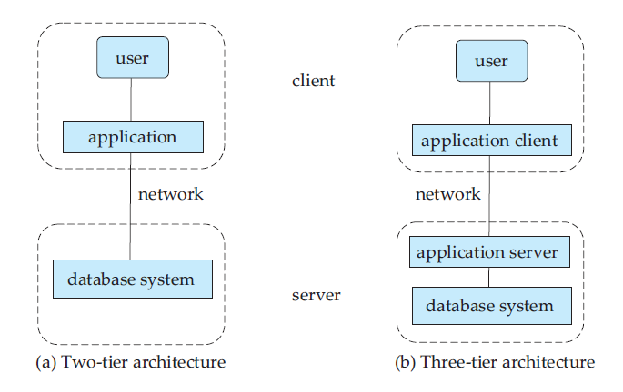
Database system Architecture

